Slide 1

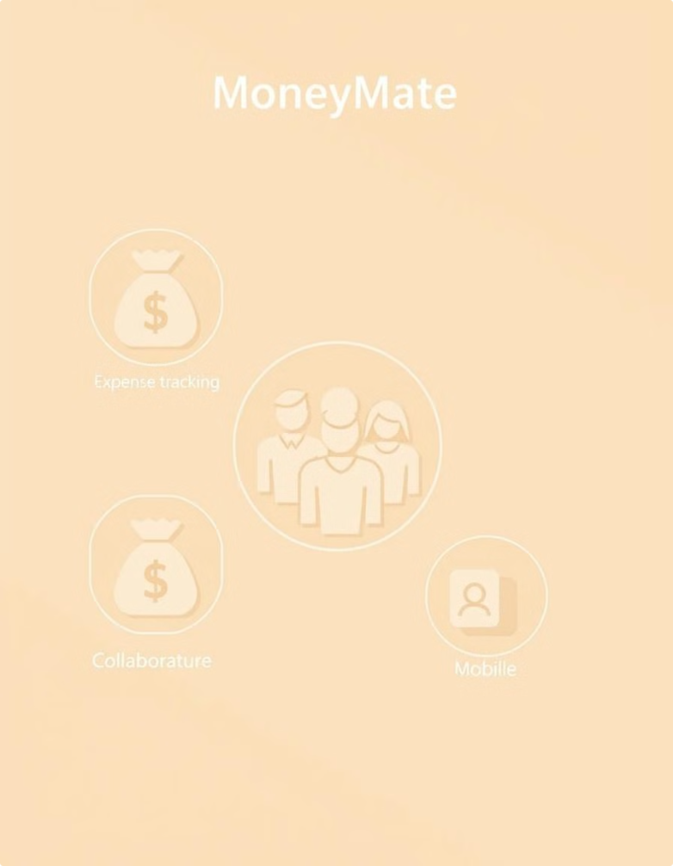
MoneyMate: Simplifying Expense Tracking & Bill Splitting
MoneyMate is a modern web application built on the MERN stack that solves the age-old problem of managing shared expenses. It simplifies expense tracking and bill splitting for individuals and groups, with features like group expense management, UPI-based payment tracking, and dynamic bill splitting.
Notes:
1

Slide 2
Design & Implementation: Simplifying Financial Collaboration
Frontend
Backend
Database
MoneyMate's frontend is built with React, providing a user-friendly and responsive interface. Bootstrap styling ensures a consistent and aesthetically pleasing experience across different devices.
The backend is powered by Node.js and Express.js, ensuring robust server-side logic and efficient API handling. The application leverages REST APIs to seamlessly communicate between the frontend and backend, ensuring smooth data flow.
MongoDB provides a flexible and scalable database system to store user information, group details, expenses, and payment statuses. The data is organized into well-defined schemas for optimal querying and management.
Notes:
2

Slide 3


Data Acquisition & Planning: Methodology
Schema Design
Relationships
Efficient data structures are crucial for efficient querying and data management. MoneyMate's schema design incorporates relationships between different data elements, ensuring efficient data retrieval and manipulation.
The application leverages ObjectIds for referencing related data elements, ensuring accurate connections between users, groups, expenses, and payment statuses, resulting in a cohesive data model.
Validation & Middleware
Data validation and middleware are implemented to ensure data consistency and integrity during operations. These safeguards prevent invalid data from being stored, ensuring a reliable and accurate data repository.
Notes:
3

Slide 4
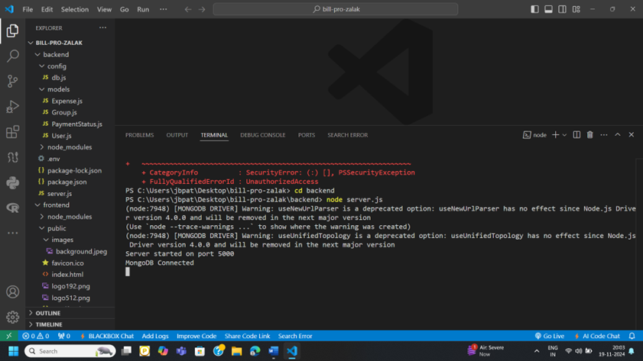
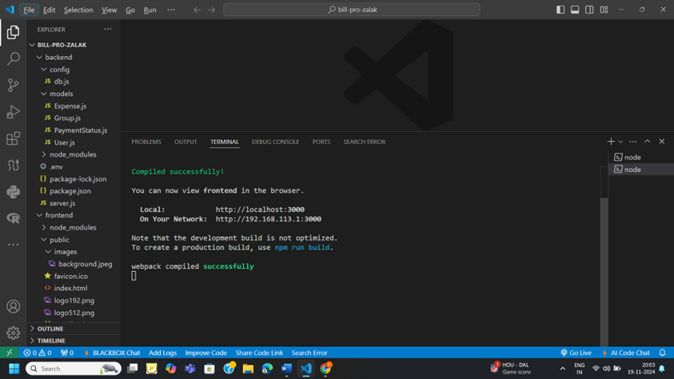
VS CODE
Notes:
2

Slide 5
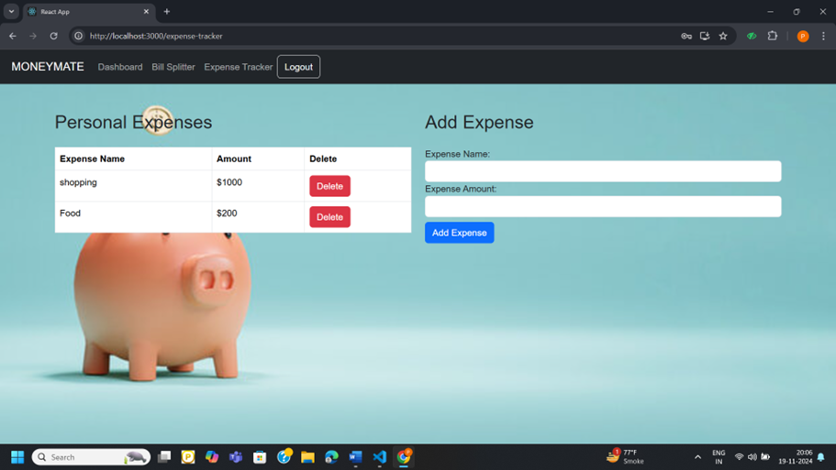
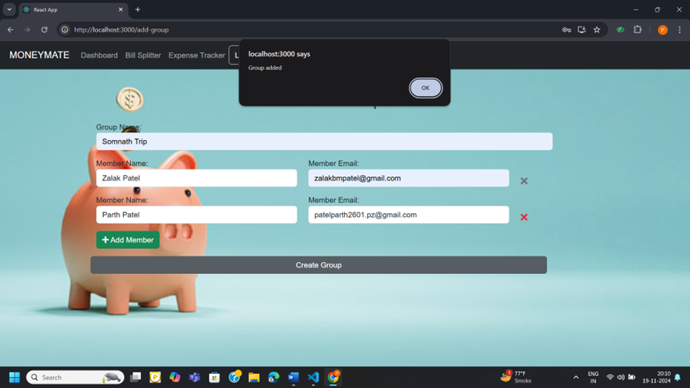
WEBSITE
Notes:
2

Slide 6
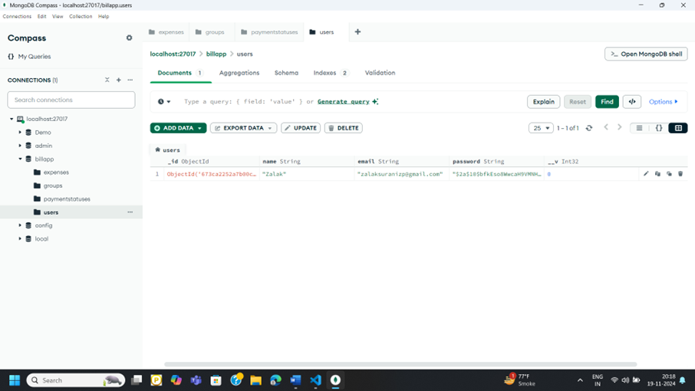
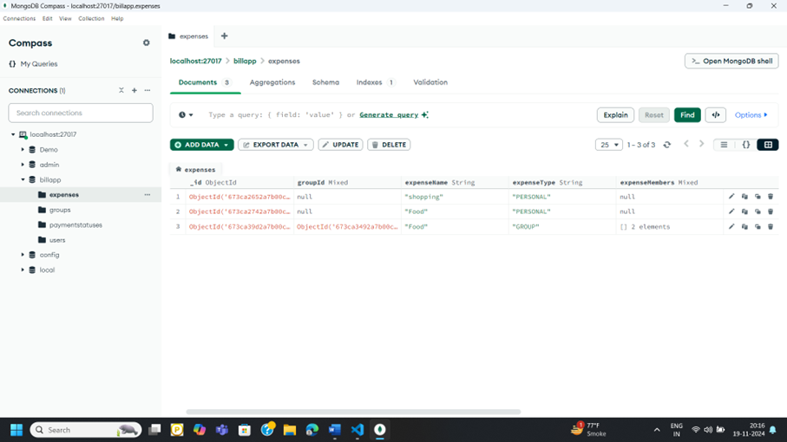
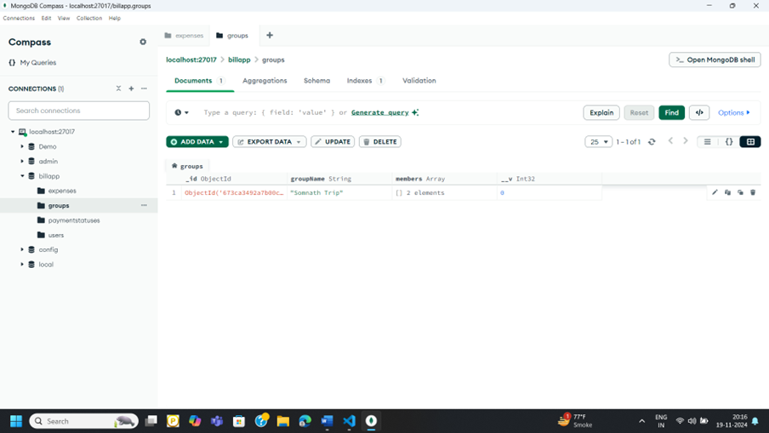
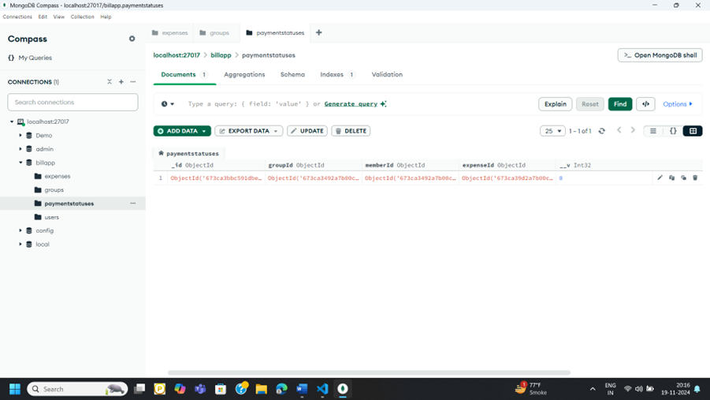
MongoDB
Notes:
2

Slide 7





Results & Discussion: Delivering a Seamless Experience
Goal
1
To simplify expense tracking and bill splitting for individuals and groups.
2
Achievements
Successfully achieved the goal through the development of a comprehensive web application.
3
Challenges
Schema interrelations and performance optimization.
4
Solutions
Efficient schema planning, API optimization, and middleware implementation.
5
Outcome
Minimal API response time, seamless UI rendering, and enhanced user experience.
Notes:
4

Slide 8




Conclusion: A Scalable Solution for Collaborative Finances
Transparency
MoneyMate promotes transparency and ease in financial coordination, making it a valuable tool for individuals and groups to manage shared expenses.
Collaboration
The application facilitates collaboration by providing a centralized platform for tracking expenses and managing shared finances.
User-Friendliness
Its intuitive user interface and comprehensive features make managing expenses a breeze, enhancing the overall user experience.
Notes:
5

Slide 9

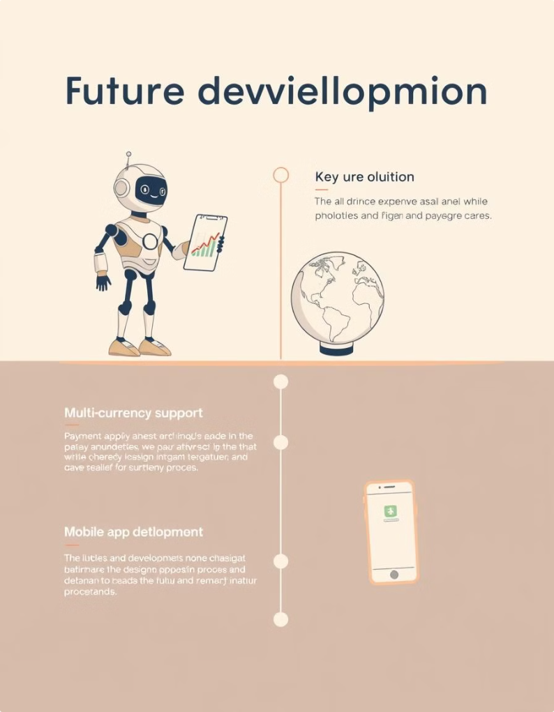
Future Work: Expanding Capabilities & Enhancing Functionality
1
AI-Driven Expense Analysis
Implementing predictive expense analysis using AI algorithms to provide users with insights and financial forecasting.
2
Multi-Currency Support
Enabling support for multiple currencies to facilitate global transactions and cater to diverse user needs.
3
Payment Gateway Integration
Integrating with popular payment gateways for seamless online payments and a streamlined user experience.
4
Mobile App Development
Developing a dedicated mobile application for improved accessibility and ease of use on various devices.
Notes:
6

